Slide 1
DemoSat: Machine Learning
Critical Design Review
Arian Rasoli
10.13.2025

Slide 2
Mission Overview
Design a robust atmospheric payload capable of detecting and measuring key atmospheric layers.
Feed measurements into a pre-trained tiny machine learning model trained on historical atmospheric data to classify the corresponding atmospheric layer
Model predicts atmospheric layers from 0 through 5 for real-time classification.
Ensure reliable payload functionality and proper error handling throughout the flight.
After flight, the use of Python will help us understand the data of real atmospheric layer measurements versus the model’s predicted classifications.
Create a tiny machine learning model that can be reutilized for future use cases in DemoSat.

Slide 3
Mission Requirements
Cost must be below $500
Temperature must withstand temperature down to -40 ºC
Payload weight must be below 800g
Pressure resistant at high altitudes
Battery must be able to withstand severe conditions
Post-Flight code data analysis
Develop documentation and code for future projects that might be done
Have a functioning/reliable TinyML model for layer classification

Slide 4
Subsystem Requirements
Power
  Our power supply (9V Battery), must be able to withstand extreme conditions while being able to supply our systems
  We will need to power our: Switch, Arduino Nano 33 BLE Sense Rev2, and BMP280, and OpenLog.
    Will be using built-in accelerometer sensor.

Slide 5
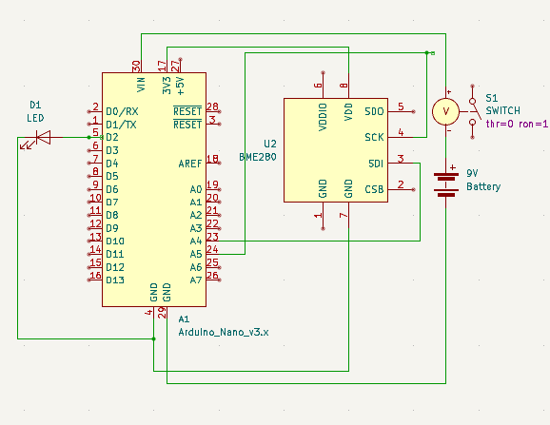
Electronics Schematic

Slide 6
Machine Learning – Neural Network Pt. 1
Sequential Model
  Algorithm to process data in significant order.
  Can interpret previous information given to understand and predict data.
Architecture
  Input: 2 features [Pressure (hPa), Temperature (C)]
  Hidden Layer: 32 input neuron, ReLU Activation
    ReLU: Activates neurons only for positive inputs
      Helps neural network learn complex patterns in data.
  Output: 6 output softmax probability.
    Softmax: converts outputs into probabilities that sum to 1.
    Each index in array represent the likelihood of payloads current layer.

Slide 7
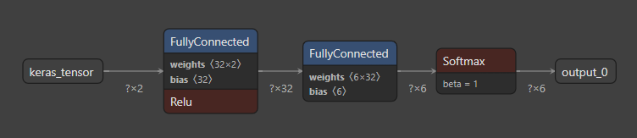
Machine Learning – Neural Network Pt. 2

Slide 8
Commands and Sensors
When Switch == ON
  Data collection starts
    BMP280
      Feed this data: temperature and pressure to model.
    From each data collected, saved onto an SD card.
      I only intend to use one 8gb SD Card for this experiment
When Switch == OFF
  Data collection is NULL

Slide 9
Testing Plans
Battery Capability
  Environmental testing, Pressure testing
Sensors
  Drop test, Functionality, Environmental
LEDs/Switch Functions
  Whip, Drop, Functionality

Slide 10
Parts List
9V battery
Sensors
  OpenLog (SD card reader)
  BMP280 (Pressure & Temp sensor)
Microcontrollers
  Arduino Nano 33 BLE Sense Rev2
Box : Most likely will settle with 3x3 or 4x4 (maybe even smaller)

Slide 11
Expected Results
The model is expected to accurately identify the atmospheric layer the payload is currently in based on sensor readings.
It will provide layer transitions (Surface, Troposphere, Stratosphere) as the payload ascends.
Based on the current accuracy of the model, I predict the model will successfully classify atmospheric layers >90% of the time under flight conditions.

Slide 12
Structure
Arian Rasoli - Team Lead, Embedded AI Systems Engineer.
Current Schedule
  PDR: 9.17.2025
  CDR: 10.14.2025
  FRR: 11.3.2025 – 11.5.2025
  Launch: 11.8.2025
  Final Report Due: 12.12.2025

Slide 13
Conclusion
I expect to have a viable system that will collect basic atmospheric weather conditions and pass it into a model for atmospheric layer classification.
I plan to optimize my weight and have the necessary systems to keep it up and running.
I plan to analyze the data post-flight to see the accuracy of the model.
I am confident that the model will work as intended and accuracy to be about 90% during flight.

